Slide 1
PPT PRESENTATION
BANK LOAN ANALYTICS

Slide 2
INTRODUCTION
Understanding Loan Performance with respect to
various Key Performance Indicators (KPIs) for
Loan disbursed to different categories of customers
in various states of US with varying interest rates
for different purposes of the loans.

Slide 3
KEY POINTS
Total No of Customers : 39,717 Nos
Total Loan Amount : $ 446 Million
Total Payments : $ 483 Million
Total Revolving Balance : $ 532 Million

Slide 4


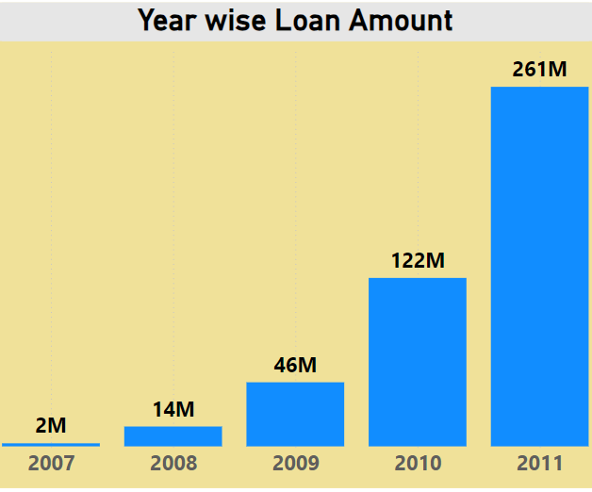

Year wise Loan Amount
Loan disbursement : Between year 2007 and 2011
Minimum Loan : $ 02 Million in Year 2007
Maximum Loan : $ 261 Million in Year 2011
Gradual increase of loan each year by more than double of the loan amount of previous year.

Slide 5
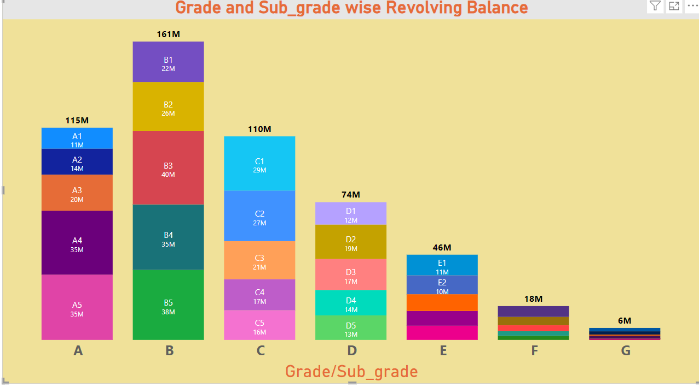
Grade and Subgrade wise Revolving Balance
Maximum Revolving Balance of $ 161 Million is with Grade B.
Within Grade-B, maximum Revolving Balance of $40 Million is with Sub-grade B3 .
Minimum Revolving Balance of $6 Million is with Grade G.

Slide 6
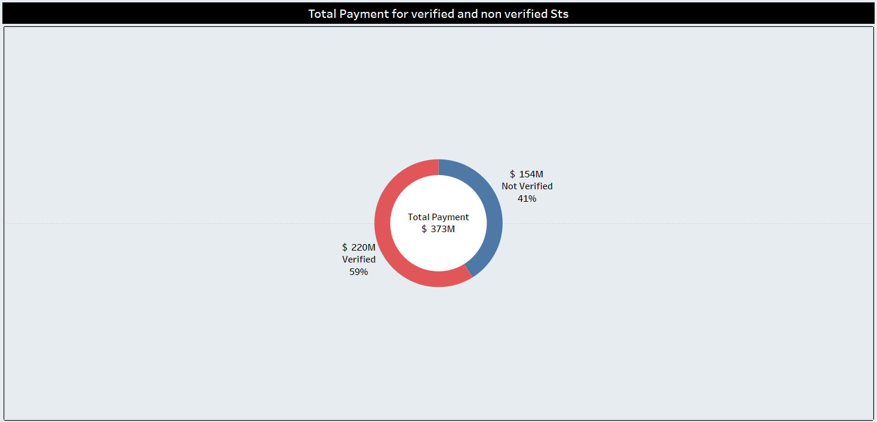
Total Payment for verified and non-verified sts
The Payments are categorized as verified,source verified and non-verified status.
Here we have analysed the Total payments for Verified status and Non-verified status.
The Total Payment for verified Status is $ 220 Million which is 59% of the Total Payments.
The Total Payment for Non-verified Status is $154 Million which is 41% of the Total Payments

Slide 7
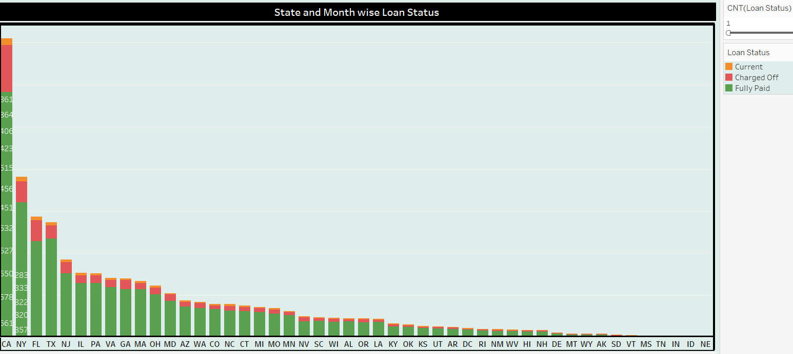
Statewise and Monthwise Loan Status
The Loan Status is classified as Fully Paid, Charged off and Current.
Maximum no of Fully paid status is in the State of CA.
Out of the Total 39,717 nos of customers the Loans of 5627 nos of Customers have been Charged -off.
Total 32,950 Nos of customers have fully paid the Loans
The Loans of 1140 nos of Customers are currently active.

Slide 8
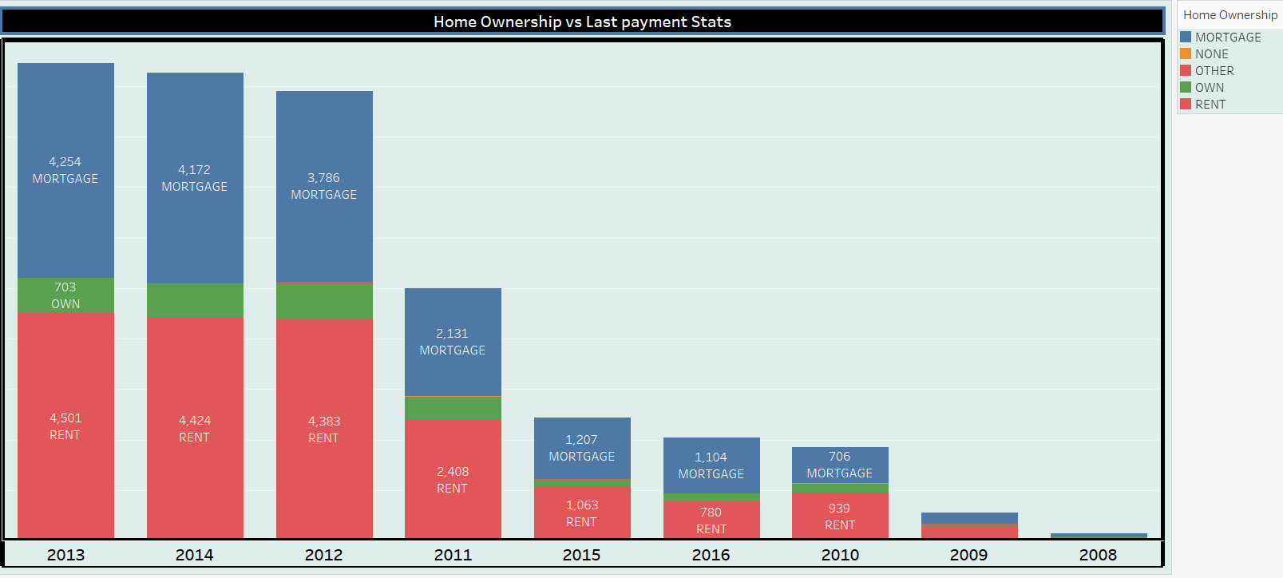
Home Ownership vs Last payment date sts
Home Ownership is classified as mortgage,rented and Own Home.
Max No of Mortgage home was 1304 nos in year 2013
Max No of Rented home was 1486 nos in year 2014
Max No of own home ownership was 221 nos in year 2012.

Slide 9
Fund investment Rate: Percentage of loans that have been invested.
Loan amount = $ 446 Million
Funded Amount =$ 435 Million
Funded Amount Invested=$ 413 Million
% of Funded Amount to Loan Amount = 97.57%
% of Funded Amount invested to Funded Amount = 94.97%

Slide 10
Interest Rate Spread
Maximum Interest Rate = 24.59% ( Grade F,G)
Minimum Interest Rate = 05.42% (Grade A,B)
Average Interest Rate = 12.02%

Slide 11
Average Loan Size: Mean amount of loans disbursed.
Average Loan Size = $ 11,219
Average Fund Size = $ 10,948 (97.58%)
Average Fund-invest Size = $ 10,397 (94.96%)

Slide 12
Profitability of Loans
Total Loan Amount = 446 million
Total Payment = 483 million
Total principal received = 389 million
Total Interest received =90 million
% Profit ( interest received /principal recvd) =23.12%

Slide 13
PURPOSE OF LOAN
Maximum Loan(appx 74%) was given for the purpose of Debt-consolidation followed by Credit card and Home improvement (i.e.330/446=74%).
Purpose Loan Amount Total pyment Principal Interest
Debt-Consolidation 236 258 206 52
Credit Card 60 66 54 12
Home improvement 34 37 30 07
Total 330 361 290 71
Profit due to above three purposes of loan =71/290 =24.48%

Slide 14
CONCLUSION
Difference between Verified and Non verified Status should be decreased by increasing the process of verification.
Special Attention should be given to A and B group customers who are the major customers.
Focus on CA(California ) State should be given which is the major contributor/loan taker.
Focus is required on the purpose of Debt Consolidation, Credit Card and Home improvement who are the major customers with appx 74% of the total amount and contributing highest interest of about 24%.
THANK YOU

